Slide 1
Design Patterns Overview

Slide 2
What Design Patterns are not
They are not one size fits all solutions to a particular problem
They do not solve the particular details of your particular problem
They are not blocks that, when composed exactly right, can solve any and all software problems

Slide 3
What Design Patterns are
They are reusable blueprints for software development.
They are good places to start when solving a well known software interaction
They are a good structure for thinking about how to develop a large software system
They are filled with tradeoffs and answers that involve “it depends”

Slide 4
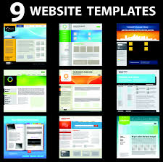

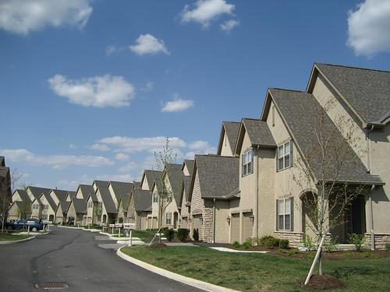
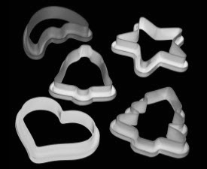
Patterns in the world around us

Slide 5
What is a design pattern?
A design pattern systematically names, explains, and evaluates an important and recurring design in object-oriented systems
Christopher Alexander says, "Each pattern describes a problem which occurs over
and over again in our environment, and then describes the core of the solution
to that problem, in such a way that you can use this solution a million times
over, without ever doing it the same way twice"
Design patterns help a designer get a design “right” faster.

Slide 6
Why are design patterns so important?
Notes:
Institutional memory...patterns happen without us even realizing.
Copy and paste is simply not effective
If every car company had to reinvent the wheel we would never get anywhere
Imagine CS012 without the STL

Slide 7
Useful Abstractions
Coding to an interface allows people to use a system without having to worry about the details, increasing reuse, decreasing development time, and allowing teams to work independently
Maximize Reuse
Write modular code that can be used in many different places, saves on re-writing or copy-pasting code
Minimizing Maintenance
Reused code creates a single reference, any code changes or bug fixes will then propagate to all references
Maximize Extensibility
Create code that is easy to add new features to without changing what has already been made
Notes:
https://api.github.com/users/octocat

Slide 8
What do I need to implement a design pattern?
Encapsulation - Objects binds data and procedures
Inheritance/Interfacing - Multiple objects can be used and referenced interchangeably
Polymorphism - Dynamic binding of requests to objects based on run-time type
Composition - Objects are composed, or formed together into a single object, to create new functionality
“Program to an interface, not an implementation”
-- Erich Gamma, Richard Helm, Ralph Johnson, John Vlissides

Slide 9
Class Inheritance
Type
Subtype
Instructors
Students
People at UCR

Slide 10
Type hierarchy
UCR_person contains:
Common data members
Name
ID
Address
Common methods
Change_address
display
UCR_person
UCR_instructor
UCR_student

Slide 11
Type hierarchy
UCR_instructor inherits the data members and methods from UCR_person. Then UCR_instructor extends UCR_person:
Specific data members
Salary
Rank
Specific methods
add_class
change_rank
UCR_person
UCR_instructor
UCR_student

Slide 12
Type hierarchy
UCR_student inherits the data members and methods from UCR_person. Then UCR_student extends UCR_person:
Specific data members
major
Classes taken
year
Specific methods
change_major
change_course
UCR_person
UCR_professor
UCR_student

Slide 13
C++ Access Control
Public:
Accessible by anyone
Private:
Accessible only inside the class, NOT by subclasses
Protected:
Accessible inside the class and from all subclasses

Slide 14
Abstract Base Class
When it doesn’t make sense to have an object of that class
In C++ use pure virtual functions; virtual functions without implementation in the base class
class UCR_person {
public:
virtual void display() = 0;
}
Indicates that display is pure (no implementation)
Display is declared virtual
UCR_person can no longer be instantiated
Notes:
Constructors and Destructors should still be declared, and defined, within the abstract base class. It should be responsible for its own data members
Scoping of an overridden function using the base class implementation (shown on previous slide)
Constructors using the constructor of the supertype:
UCR_professor(int a,string b,int c,string d) : UCR_person(a,b) { … }

Slide 15
What do I need to implement a design pattern?
Encapsulation - Objects binds data and procedures (cpp.sh/5lhuc)
Inheritance/Interfacing - Multiple objects can be used and referenced interchangeably (cpp.sh/3s7nb)
Polymorphism - Dynamic binding of requests to objects based on ruon-time type (cpp.sh/2wyfj - Polymorphic using virtual function)
Pure Virtual function and Abstract class(cpp.sh/4o5eb)
Composition - Objects are composed, or formed together into a single object, to create new functionality
“Program to an interface, not an implementation”
-- Erich Gamma, Richard Helm, Ralph Johnson, John Vlissides

Slide 16
Inheritance vs. Object Composition
Inheritance is considered white-box reuse
Internals of parent class are visible to children
Redesign of parent causes redesign of children classes
Statically determined at compile time
Object composition is black-box reuse
Internals of object in the composition are hidden from other objects
Redesign of internals of an object don’t require redesign of other objects
Redesign of interface of an object requires redesign of other objects
Dynamically determined at run-time

Slide 17
Structure of design patterns (Example)
Pattern Name
Problem
Solution
Consequences
Composite
Code treats primitive and container objects differently, even if the user treats them similarly
An abstract class the represents both primitives and containers with the same interface
Consequences
Makes the client simple
Defines class hierarchies
Makes adding new components easy

Slide 18
Design Pattern Classification
Purpose
Creational
Concerned with object creation
Structural
Composition of classes or objects
Behavioral
Characterize interactions of classes or objects
Scope
Class
Pattern applies primarily to classes
Object
Pattern applies primarily to objects
Notes:
Class patterns deal with relationships between classes and their subclasses, established through inheritance and so are static
Object patterns deal with object relationships which are more dynamic and can be altered during run-time
This merely describes the focus, most patterns will deal with both

Slide 19
Design Pattern Classification
 |  | Purpose
 |  | Creational | Structural | Behavioral
Scope | Class | Factory Method | Adapter (class) | Interpreter Template Method
 | Object | Abstract Factory Builder Prototype Singleton | Adapter (object) Bridge Composite Decorator Facade Flyweight Proxy | Chain of Responsibility Command Iterator Mediator Memento Observer State Strategy Visitor

Slide 20
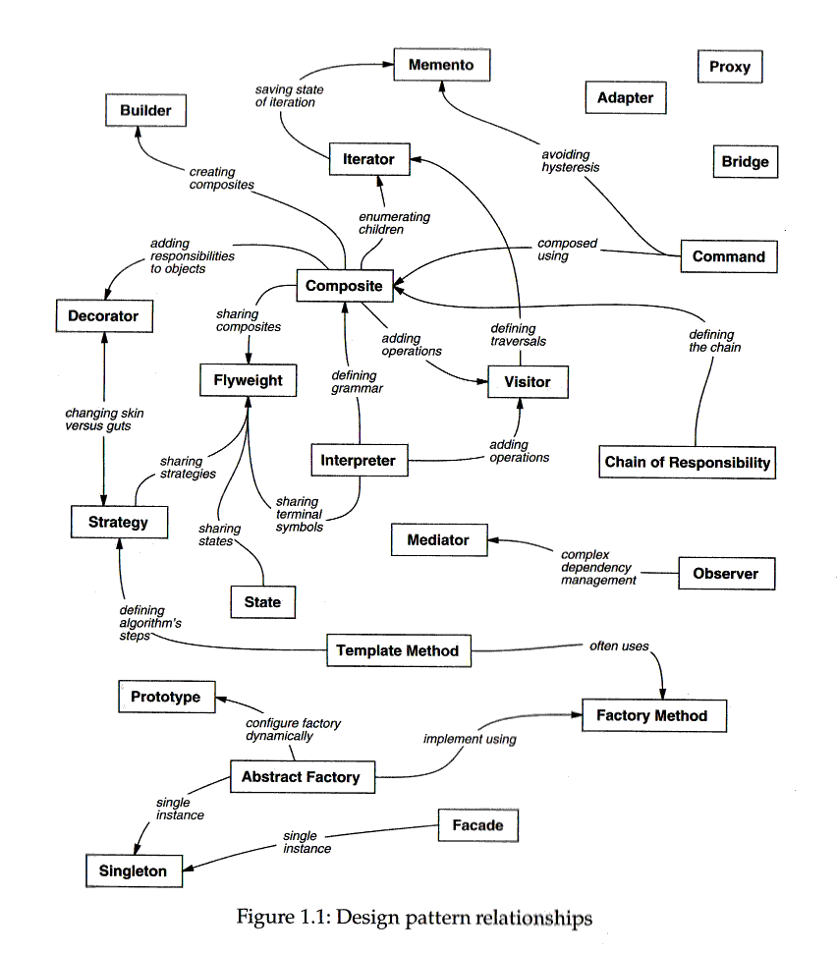
How to
select a
design pattern
Notes:
May want to move this to a review slide at the end of the quarter

Slide 21
How to select a design pattern?
Consider how design patterns solve design problems
Review the intent of the design pattern
Review how the patterns relate to one another
Select a pattern or a group of patterns
Review similar patterns
What might cause you to redesign your system?
What do you want to be easy to change in your syst.
Notes:
May want to move this to a review slide at the end of the quarter

Slide 22
Course
Overview
Creational Patterns
Structural Patterns
Behavioral Patterns

